Slide 1
Innovative approaches to thyroid disease diagnosis and forecasting
TEAM MEMBERS :
N. JYOTHI PRIYA -21MIS0417
S.VARUN KUMAR-21MIS0462
PH: 9159185309 /6382555591

Slide 2
ABSTRACT:
Thyroid classification presents significant challenges in clinical practice due to the complexity and variability of thyroid diseases and nodules. Traditional diagnostic methods rely heavily on subjective interpretation, leading to inter-observer variability, potential misdiagnosis, and delays in appropriate treatment. This underscores the urgent need for more accurate and efficient classification methods. In response, this study explores the use of machine learning techniques to address these challenges. The goal is to develop robust, reliable models that can effectively distinguish between various types of thyroid nodules and diseases. These models will leverage diverse data sources, including medical imaging, clinical features, and genetic information. By overcoming the limitations of conventional methods, the proposed machine learning models aim to provide clinicians with objective, automated tools that can enhance diagnostic accuracy and support better-informed treatment decisions.

Slide 3
Objective:
To Develop and evaluate machine learning-based models for the accurate classification of thyroid nodules and diseases. Specifically, the objectives are:
To design robust machine learning models capable of differentiating between various types of thyroid nodules and diseases using a range of data sources, including medical imaging, clinical features, and genetic information.
To assess the effectiveness of different machine learning algorithms in terms of accuracy, sensitivity, specificity, and overall diagnostic performance.
To reduce inter-observer variability and enhance the reliability of thyroid disease diagnosis by providing clinicians with an automated, objective decision-support tool.
To explore the integration of multimodal data (e.g., imaging, clinical data, genetic information) for improving model performance and diagnostic precision.
To contribute to the improvement of clinical decision-making, enabling timely and accurate treatment for patients with thyroid conditions.

Slide 4
Scope:
1. Data Collection and Preprocessing:
The project will collect data on thyroid nodules and diseases, including medical images (ultrasound, CT scans), patient information (e.g., demographics, medical history), and genetic data when available.
2. Model Development:
Different machine learning methods, including Random Forest, SVM, and Convolutional Neural Networks (CNN), will be used to develop models that can distinguish between benign and malignant thyroid nodules.
3. Model Evaluation:
The models will be tested using metrics like accuracy, precision, and recall to assess their performance.

Slide 5
4. Integration of Multimodal Data:
The project will combine data from multiple sources (e.g., images, clinical data, genetics) to improve the model's performance and diagnostic accuracy.
5. Clinical Application:
The goal is to create an automated tool that assists doctors in diagnosing thyroid conditions, reducing errors and speeding up the process.
6. Limitations and Future Work:
The project will focus on available datasets, so it may not cover all thyroid diseases.
Future work will explore improving the models and incorporating more diverse data sources for broader applicability.

Slide 6
Module description:
1. Data Collection:
Gathering diverse and comprehensive data relevant for thyroid classification, including medical images (e.g., ultrasound, CT scans), clinical features (e.g., patient demographics, test results), and other pertinent data sources.
2. Data Preprocessing:
Preparing the dataset for machine learning by cleaning the data, handling missing values, standardizing or normalizing features, and splitting the dataset into training, validation, and test subsets.
3. Feature Extraction and Selection:
Extracting meaningful features from the data, such as radiomic features from images or statistical analysis of clinical data. Feature selection techniques are applied to identify the most important features for the classification task.

Slide 7
4.Model Selection and Training
Choosing appropriate machine learning models (e.g., decision trees, SVM, random forests, CNNs, ensemble models) and training them on the preprocessed dataset using the extracted features.
5. Model Evaluation
Evaluating model performance using metrics like accuracy, precision, recall, F1-score, and AUC-ROC. The model is assessed on a separate test dataset to measure generalization and effectiveness.
6. Model Optimization and Validation
Fine-tuning model parameters and using hyperparameter optimization techniques to improve performance. The optimized model is validated on independent datasets to ensure its generalizability and reliability.
7. Interpretation and Deployment
Interpreting the model’s predictions and understanding the factors influencing its decisions. Visualization techniques and feature importance analysis help in explaining the model's behavior. Finally, deploying the model into a clinical environment for real-time use.

Slide 8
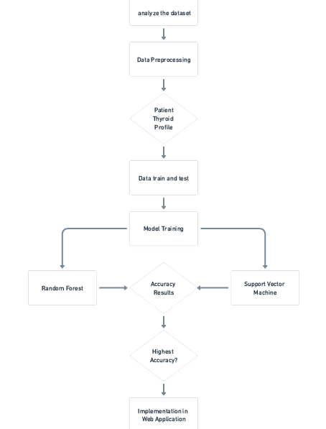
Flowchart:

Slide 9
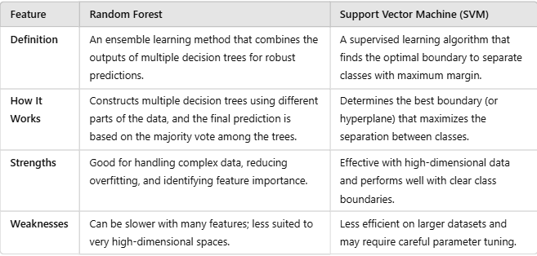
Comparison between machine learning techniques
Why SVM is Used: In this project, SVM was selected because it demonstrated higher accuracy than Random Forest on the thyroid dataset

Slide 10
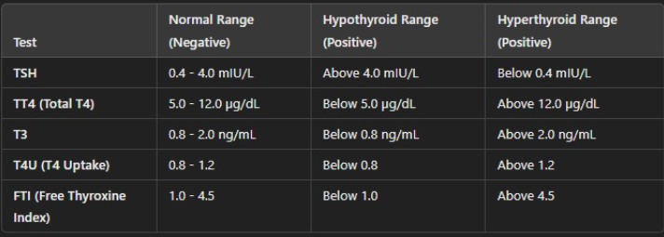
RANGES:

Slide 11
Web application :
1. Train SVM Model :
Preprocess Data: Clean and prepare the dataset (features: age, sex, TSH, T3, TT4, T4U, FTI).
Train the SVM: Use scikit-learn’s SVM to train the model on the prepared data.
Save the Model: Save the trained SVM model using pickle.
2. Build Stream lit Web Application:
Create User Interface: Design an interface where users can input data (age, sex, and medical info).
Load Trained Model: Import the saved SVM model into the Stream lit app.
Preprocess Inputs: Format the user inputs for SVM prediction.
3. Display Results:
Predict with SVM: Use the SVM model to make predictions based on the input data.
Show Diagnosis: Display the prediction result (diagnosis) on the app for the user.
“Stream lit” is an open-source Python library that allows you to quickly create interactive web applications for machine learning

Slide 12
THANK YOU

